Slide 1



This project is
co-funded by the European Union
Project overview

Slide 2
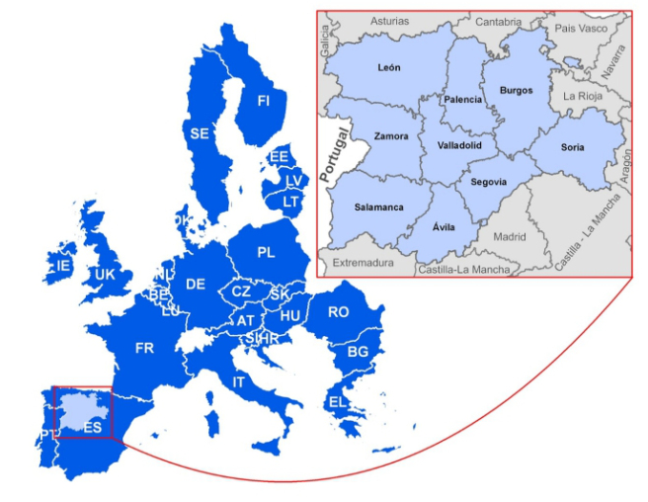
context
This project is
co-funded by European Union
PACT was one of the seven projects selected by the European Commission to be co-funded by the EaSI 2014 call (Grant Agreement VS/2015/0211).
It lasts three years (November 2015 – October 2018) and it is fully developed in Castilla y León.
The European Commission co-funds PACT with 1,97 M€ (71%) and the remaining amount until a total of 2,78M€ (29%) is provided by the partners of the project.

Slide 3
context
This project is
co-funded by the European Union
PACT is a project led by the Regional Social Services Management in Castilla y León addressed to investigate and develop innovative methods and solutions in social services. It is aligned with the European Commission through EaSI call and the SIP (Social Investment Package).
Social Services in Castilla y León
EaSI
SIP

Slide 4
context: social investment
This project is
co-funded by the European Union
The challenge for the Social Investment Package is:
To ensure that the social protection systems respond to the people needs in the critical moments of their lives. To invest early in order to avoid later difficulties and “prepare” people for life’s risks instead of only “reparing”.
It is particularly outstanding the critical role of the services of high quality integrated and personalized.
It suggests to incorporate some strategies with which the Social Services of Castilla y León were already fully aligned:
One-stop-shop --> Unified access
Innovative partnertships --> Protection Network
high quality case handlers --> Case manager…
SIP
CyL

Slide 5






partners
This project is
co-funded by the European Union
PACT counts with the following partners:
Local entities:
Third Sector Entities of Social Action of Castilla y León:
Research Institute:
Leader of the project:

Slide 6
what is PACT?
This project is
co-funded by the European Union
P
ro -
A
It can be translated like the search for an specific model of intervention based on the proactive management of the case for social inclusion
ctive
C
ase-based
T
argeted model

Slide 7
what is PACT?
This project is
co-funded by the European Union
Principal challenges:
Overcoming the fragmentation of social services
Moving social services care towards a proactive approach (vs reactive)
Focus social attention from an appreciative approach of the services ‘users, which participate in decision making.
Notes:
What is PACT?
.

Slide 8
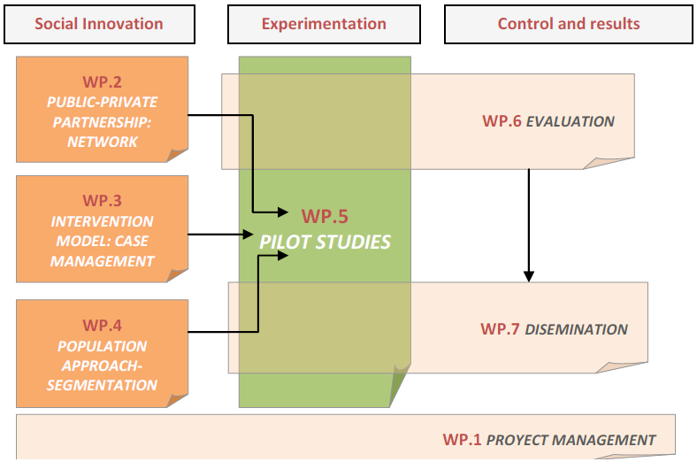
work plan
This project is
co-funded by the European Union
The project will last 36 months, from November the 1st 2015 to October 31th 2018.
1st Phase: DESIGN AND DEVELOPMENT (13 months)
2nd Phase: PILOTS (20 months)
3rd Phase : FINAL EVALUATION AND DISSEMINATION (3 months)

Slide 9
how is it developed?
This project is
co-funded by the European Union
The Project is organized in three phases During the first phase it was gathered the needed knowledge to design the models and tools. In the second one (pilot) takes place the experimentation with professionals and real cases in the PACT territories. Finally, the evaluation and dissemination of results will be carried out, inside and outside of Castilla y León.
HS
PILOT LEÓN
HS
PACT PARTNERS
HS
NETWORK PARTNERSHIP
PILOT SALA-MANCA
BENEFICIARIES
HS
HS
INTERVENTION MODEL
PACT
POPULATIONAL APPROACH
PILOT VALLA-DOLID
HS
3
DISSEMINATION
PILOT COUNCIL VA
HS
EVALUATION
1
DESIGN
2
EXPERIMENTATION
Strategies
Boundary partners
Beneficiaries
Community

Slide 10
what is PACT?
This project is
co-funded by the European Union
PACT is experimenting about three simultaneous innovations
PACT
NETWORK PARTNERSHIP
POPULA-TIONAL APPROACH
(SEGMENTATION)
ADVANCED MODEL OF CASE MANAGE-MENT
SHARED RESOURCES
SHARED
DATA
COMPREHENSIVE INTERVENTION
SCREENING,
MAPS…
KNOWLEDGE
ONTOLOGY
RISK / OPPORTUNITIES
DETECTION = ALERTS
Notes:
What is PACT?
PACT is experimenting with three simultaneous uinnovations
Network partnership
Populational approach
Advanced model of case management

Slide 11
what is PACT?
This project is
co-funded by the European Union
NETWORK PARTNERSHIP
In the framework of the Protection Network for Families it is now being tested a collaborative model between public entities and Third Sector entities of Social Action in Castilla y León.
It includes:
Shared information: to integrate and share information in order to better address the people needs.
Multiagent approach: shared resources for an integrated, coherent and efficient intervention.
Common procedures and languages: network of professionals sharing tools for the diagnosis, intervention and monitoring.
Collaborative professional network: professionals with situational roles that support each other and work together, even if they belong to different entities.

Slide 12
What is PACT?
This project is
co-funded by the European Union
NETWORK PARTNERSHIP
Alignment and opportunities: The Protection Network
PACT is fully aligned with the Draft of the Law for the Organisation and functioning of the Network of Protection to families… and offers an interesting practical experimental field where testing the design of essential postulates:
Innovative public-private asociation
Information shared among agents
Integration of resources: map of resources
Case management
In this way, PACT will generate evidence and knowledge that will be very useful for the future deployment of the law.

Slide 13
what is PACT?
This project is
co-funded by the European Union
POPULA-TIONAL APPROACH
(SEGMEN TATION)
Implies to incorporate proactivity to the system through the analysis of a large volume of information (data) and also through the elaboration of ontologies that explain the processes of exclusion identifying vulnerabilities and risks to act beforehand with the appropriate strategies:
Integration of data: to integrate the information of the public system and the Third Sector for its treatment through data processing techniques.
Scientific evidence of the phenomena: to find the association among factors that allow to explain the complex phenomena linked to social exclusion (ontology of vulnerability).
Elaboration of the adequate strategies and protocols: as suggestions and support to the professional system (case manager) for a better response.
Alerts and screening system: the professionals will receive alerts on concrete situations and the system will be able to identify risks and opportunities on which to offer proactive and preventive actions.

Slide 14
what is PACT?
This project is
co-funded by the European Union
advanced model of case management
Starting from the knowledge gained by the professionals, a model and shared tools are developed for the intervention with cases of people in or at risk of social exclusion with an special complexity.
It includes:
Multidimensional approach: Diagnosis of the situation of each person in multiple aspects with the help of standard tools that gather and relationate the present significative factors.
Personalized integrated approach: The approach of each case is integrated. A strategy is defined; considering the current and future attentions, benefits and services (regardless the provision being public or private) and personalizing the package of responses.
Appreciative approach: Not only the needs, deficiencies or vulnerabilities are evidenced, but also the strengths and potentialities.
Participative approach. Empowerment: the user shares the diagnosis, leads his/her own itinerary and receives accompaniment.

Slide 15
This project is
co-funded by the European Union
PACT
NETWORK
PARTNER-SHIP
ADVANCED MODEL OF CASE MANAGE-MENT
POPULA-TIONAL APPROACH
(SEGMENTATION)
Pilots experimentation

Slide 16

pilots - experimentation
This project is
co-funded by the European Union
The pilots are planned with real cases (research):
selection of scenaries (territories)
selection of experimental sample (184 initial cases with MGI)
selection of the sample for the control group (184 matching cases)
creation of 4 pilots teams (12 professionales c/u) with support
Scheme of each pilot
Experimental group (2 CEAS)
Control group (2 CEAS)
Pilot team
(intervention)
Support team
Territorial Managing Authority
Local Entity
NGO Entities
Social workers from 2 CEAS
2nd level professionals from Local Entity
NGO professionals
46 GMI beneficiaries from 2 CEAS, with different characteristics
Beneficiaries from other CEAS with the same profile for matching one to one

Slide 17
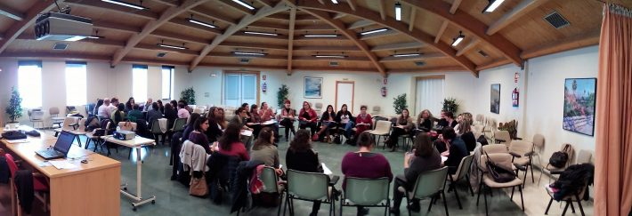
pilots - experimentation
This project is
co-funded by the European Union
The first working session with pilots teams took place on February 2017
First training session with pilot teams of León, Salamanca and Valladolid (08/02/17)

Slide 18
pilots - experimentation
This project is
co-funded by the European Union
184 initial cases are distributed among the 48 case coordinators.
The distribution criteria are: territory, link, professional specialty and racionalization (min. 2 – max. 5 cases per professional).
184 people are formally invited to voluntarily participate.
The experimental intervention is explained and the informed consent of the person is requiered.
143 people are initially willing to participate in the experimental intervention.
41 people (22,3%) refused to participate.

Slide 19
pilots - experimentation
This project is
co-funded by the European Union
The intervention implies to diagnose (MDTSE), to visualize horizons / decide exits, to ellaborate a case plan and to accompany the user in its execution
Discover
To stablish a context (re-approach).
Joint analysis of the situation (MDTSE).
Change in the approach (from deficiency to appreciative).
TO VALUE the reality.
Dream
To show aspirations and desires by the user.
To consider what does work in the system.
To identify points of leverage.
TO VISUALIZE the horizont.
Design
To Project steps towards that horizont.
To set up timelines.
To determine needed support and strengths.
Contract
(Case Plan).
TO SUGGEST a change.
Destiny
To advance in the projected Case Plan.
Accompanying.
Movilization of support and resources.
Measurement of change.
CLOSING.

Slide 20
This project is
co-funded by the European Union
The evaluation of the project

Slide 21
objective of the evaluation
This project is
co-funded by the European Union
To measure the effects that this new model of intervention has on people experimenting situations of vulnerability (GMI beneficiaries)
To identify resistances / opportunities
To measure opportunities
To measure the (organisational, time and tasks) cost
To measure the impacts: scopes and learnings
To study the transferability of the results

Slide 22
core hypothesis
This project is
co-funded by the European Union
Leaving a situation of poverty and dependance of public resources depends on two main factors:
Participant’s role: the person should assume an active role in the search of opportunities, instead of being a passive recipient of public resources.
The professionals’ work methodology: go over a directive model in which the professional designs the itinerary and assume a rol of help and accompaniment.

Slide 23
principles of the model
This project is
co-funded by the European Union
The Network: collaborative work between public Administration and Third Sector entities
The coordination of services, resources and professionals
Participant’s proactivity
Person centered intervention
Appreciative approach
Participant’s empowerment

Slide 24
This project is
co-funded by the European Union
characteristics of the evaluation
It is an INTERN EVALUATION as the evaluator is a partner of the project.
It is a FINAL EVALUATION focused on pilot results, carried out by the DEPARTMENT OF SOCIOLOGY of the University of Valladolid.

Slide 25
This project is
co-funded by the European Union
moments of the evaluation
The evaluation has been a CONSTANT PROCESS of learning
It means a mechanism of MONITORING the process of work, ellaborating different reports of evaluation in each phase of the process of intervention: implementation / training of professionals; pilot phase.

Slide 26
This project is
co-funded by the European Union
methodology
Cualitative methodology: interviews, participant’s observation, Focus Group.
Cuantitative methodology: statistic analysis of different tools (Questionnaires)

Slide 27
This project is
co-funded by the European Union
deliverables
Initial Plan of Evaluation
Strategy of Evaluation for the pilot phase
Selection of both pilot and control samples
Ellaboration of tools for the evaluation
Ellaboration of synthetic indexes for user’s actitude (supplementary to MDTSE)
Initial evaluation report: Ex ante evaluation: study and analysis of already available data of GMI beneficiaries in the four countries of PACT.
Intermediate evaluation report: study and analysis of the process of PACT culture implementation:
Participant’s observation
Interviews
SWOT analysis
Statistical analysis of the pilot sample
Initial phase study report (discover): characteristics of the pilot sample:
Participant and professional’s self-valuation
Attitude scale
Field notebook
Basic analysis of the intervention
Control group evaluation report
Final evaluation: Ex post evaluation- evaluation of scopes

Slide 28
This project is
co-funded by the European Union
tool of the evaluation
Support Team
Incident report
Case Coordinators
Professional’s self-valuation
Field notebook
Basic elements for the intervention
Users
User’s self-diagnosis
Attitudinal scale
Synthetic index for user’s attitudes

Slide 29
This project is
co-funded by the European Union
content of the tools
PROFESSIONAL’S SELF-VALUATION QUESTIONNAIRE: main axis of the tool:
Possibilities of change in the participant’s situation by the use of MDTSE
Timing and intensity of professional work
Administrative and institutional difficulties
Return to traditional models of intervention
Opinion regarding the scale of change that PACT culture means

Slide 30
This project is
co-funded by the European Union
content of the tools
USER’S SELF-DIAGNOSIS: aspects taken into account:
Qualities that better define the individual.
His/her willingness to renounce to something in order to get a job.
Laboural habilities.
People the participant counts and get on.
People he/she turns to.
Most valued and worth living aspects.
Personal future perspectives.
Current goals and plans in his/her own life.
Level of reliance on a change in his/her current situation.
Level of personal motivation when coping with future challenges.

Slide 31
This project is
co-funded by the European Union
content of the tools
ATTITUDINAL SCALE: focused on the next areas:
Emotional welfare
Personal relationships
Personal development
Self-determination
Social Inclusion and Rights
FIELD NOTEBOOK: It is a simple document that allows to the Case Coordinator to gather all the main tasks that each participant is implementing.
BASIC ELEMENTS OF THE INTERVENTION: diagnostic valuation carried out by the Case Coordinator of the participant’s attitudes and perceptions.
User’s attitudes
Environment in the intervention process
Arrangements
Responsibilities assumed
User’s attitud evaluation
Progresses made

Slide 32
results
This project is
co-funded by the European Union
Scope in the system
Scope in the professionals
Scope for the citizen
IMPACTS
(short term)
The system provides:
Legal basis
Technological basis
Organizational basis
Resources and support
For the development of a system of Network care
The professionals:
Appreciative approach
Work under the network
Proactive
Generating a change in the professional role
The users:
Are aware of their situation
Have a life purpose
Develop autonomy
Final success of PACT Project
There are impacts on:
The situation of exclusion of the users and their families
The Social Services attention system
Which allow to measure the efficiency of the project
Information resources:
Legal base developed
Software products from PACT
Resources available for the Project
Commitment for the deployment of the model
Interoperability
Information resources :
Interviews and questionnaires for the evaluation
Information gotten from the participant’s observation
Information resources :
Interviews and questionnaires for the evaluation
Information resources :
Databases from Gerencia de Servicios Sociales
Databases from the Third Sector Entities
MDTSE
Interviews and questionnaires for the evaluation

Slide 33
results
This project is
co-funded by the European Union
Until now, PACT has already addressed:
Cocreate the essential elements for a collaborative professional intervention between public and private entities.
Generate agreements on a common language and model of intervention.
Promote the ellaboration of basic instruments in the context of the Protection Network (software NETWORK-PACT).
Experimentate mechanisms to share information and to manage cases in a collaborative manner.
Develop a software to record the resources of the Network and other fundamental instruments (Resources Map of the Protection Network).
Ellaborate basic tools like MDTSE to diagnose situations and orientate interventions.
Identify some risks and taking the initial steps in the proactive management of those risks when facing complex cases.

Slide 34
results
This project is
co-funded by the European Union
Moreover, PACT must achieve:
The discovery of different strategies suitable for different risks and profiles in order to provide a better service.
Stablish languages, tools and usefulness that allow the spread of a collaborative model in the whole territory of Castilla y León.
Create scientific knowledge (based on evidences) regarding the ontology of the exclusion.
Supply the necessary minimum elements to make of the collaborative work between agencies a reality.
Provide knowledge for a case management orientated to results
…

Slide 35
results
This project is
co-funded by the European Union
PACT locates the social services in Castilla y León at the forefront of the European social services systems, being the only initiative focused on the simultaneous investigation, experimentation and implementation of:
A new organisational model: the innovative and collaborative public-private partnership (Protection Network)
New technologies at the service of the care model: proactivity when managing risks and opportunities
A professional intervention adapted to the person: appreciative, addressing the empowerment and personalised.
It means a great drive to the strategies of innovation in Social Services and allows a future full of opportunities

Slide 36
PACT
NETWORK PARTNERSHIP
POPULA-TIONAL APPROACH
(SEGMENTATION)
ADVANCED MODEL OF CASE MANAGE-MENT
This project is
co-funded by the European Union
Products and deliverables

Slide 37
map of resources
This project is
co-funded by the European Union
Consensus
definitions
Registry content
Products utilities
Catalogue of benefits
Typology of resources
Professional roles
Entities
Resources: centers or services
Benefits and actions
Network Map of resources
Management of permits to professionals from the Network
Interoperability

Slide 38
map of resources
This project is
co-funded by the European Union
MAP OF RESOURCES OF THE NETWORK
As an instrument to order the available resources from the Network in an homogeneous way.
It allows:
to always ensure the correct use and an authorized Access by the user
interoperability among agents since benefits and services (public or private) own a common name referred to the Social Services Catalogue
to know the extension and coverage of social services in people and territories
to align efforts in order to obtain better results for the people

Slide 39
Electronic Shared Social Record (ESSR)
This project is
co-funded by the European Union
What is shared and with what purpose?
Information
SHARED SOCIAL RECORD (ESSR): Gathering of relevant and systematized information provided by the public system (SAUSS) and by the Third Sector entities (NGO´s) working with the person.
Common tools, procedures and languages
INTERVENTION MODEL; ASSESSMENT and DIAGNOSIS TOOL; CASE PLAN and PERSONALISED INTERVENTION: integrated in an application NETWORK-PACT that automatizes shared elements and guarantees security and traceability.
Resources
Especially those integrated in the RESOURCES MAP OF THE PROTECTION NETWORK.
Overcoming the fragmentation of social services intervention

Slide 40
ESSR structure and usefulness
This project is
co-funded by the European Union
ESSR structure:
User’s identity (ID number, date of birth/death, gender, nationality, address…)
User´s profile (civil status, academic background, previous employment)
Family coexistence unit (members info and co-resident unit profile)
Administrative procedure (applications, procedure phase)
Professional Attendance (case manager and others)
Evaluations and assessments (needs, diagnosis)
Social interventions (services and intervention contents)
Monitoring (date of next monitoring, monitoring results)
Documents (reports, assessment tools, administrative resolutions)
Signed with ✓ some contents of Summary ESSR
Notes:
- Data from the managment of the information in Social Services
Person profile (nationality, age, gender, civil status, typology of classification MII (mínimum integration income), time in MII, academic background).
Profile of the living unity.
Pathway of valuation and care benefits by the basic social services. Graph of the services pathway.
Pathway of valuation and care by the Third Sector.
Summary of information by dimensions: residential, employability, health, personal, relational, dependency on the Social Services system.

Slide 41
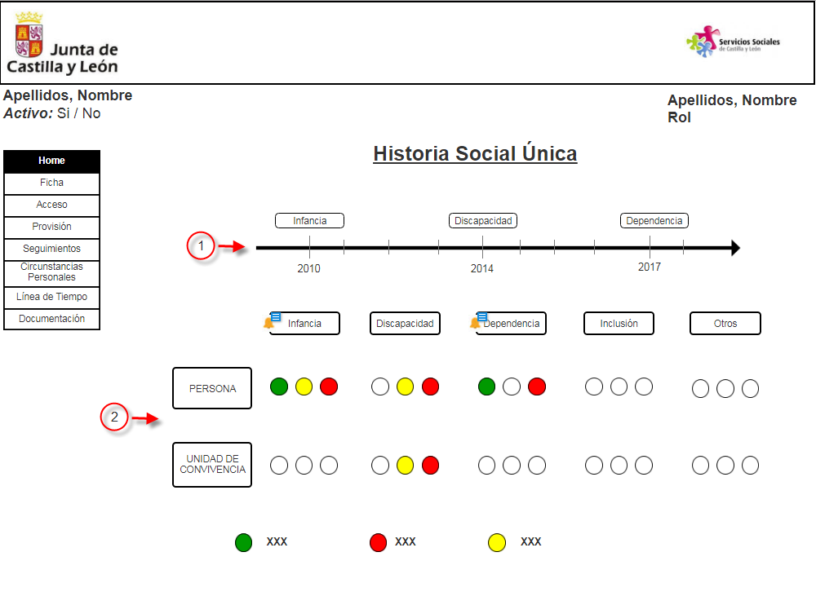

ESSR architecture and views
This project is
co-funded by the European Union
Public responsibility social services system normative:
LAW: 16/2010 Castilla y León social services Act
DECREE: 79/2015 social record and social data repository
ORDER: FAM/628/2017, social services users registry
ESSR views
View 1
ESSR
Summary view
View 2
View n
SOCIAL DATA REPOSITORY
Electronic Shared Social Record –ESSR-
Access Control
Periodic data upload
Social services application: SAUSS
Social services application 2
Social services application 3
Social services application 4
…
Role 1
Role 2
Role 3
Role 1
Role 2
Role 3
Role 1
Role 2
Role 3
Role 1
Role 2
Role 3
ESTANDARDISED TERMINOLOGY (SIUSS)

Slide 42
ESSR interoperability
This project is
co-funded by the European Union
SDR
Maximise cooperation
Minimise dependency
Social Data Repository
DIRECT ACCESS TO SAUSS NETWORK PACT
OR UPLOAD FROM THEIR OWN IT SYSTEMS
SAUSS NETWORK-PACT
IT SYSTEM
NGO´S
IT SYSTEMS
INTEROPERABILITY
-
standards

Slide 43

.
proactive approach: risk segmentation
This project is
co-funded by the European Union
High
risk
No risk
Low risk
Medium risk
E
Risk Groups
Intervention Strategies
C
Risk 3
Risk 2
Risk 1
B
Strategy 3
A
Strategy 2
Segmentation
Strategy 1
People at risk of poverty chronicity and social exclusion
People with opportunities for social inclusion

Slide 44
proactive approach: design of the ontology
This project is
co-funded by the European Union
There is progress in the ontology of exclusion and there is use of data ingeneering and professional knowledge for:
identification of risks related to exclusion (ethiologies, related factors and interactions).
construction of a predictive algorithm of risks (for example: chronicity of MGI dependency) through procedures of machine learning.
the prior information is removed from the cases of the sample to build up conglomerates of information.

Slide 45
proactive approach: requirements and results
This project is
co-funded by the European Union
Data integration: to integrate the information of the public system and Third Sector for its treatment through data processing techniques.
Scientific evidence of the phenomena: to find the association among factors that allow to explain the complex phenomena linked to social exclusion (ontology of phenomena).
Alerts and screening: professionals will receive alerts on risks and opportunities to offer proactive and preventive actions.
Strategies and protocols: as professionals (case managers) will receive support for better interventions.

Slide 46



Supporting social services professionals on intervention decision making
proactive approach in practice
This project is
co-funded by the European Union
User’s profile | High risk | Moderate/medium risk | Low risk
Priority profile | Atención prioritaria Proactividad inmediata | Seguimiento programado Proactividad diferida | la autonomía En los contactos
Technological solution
Intervention content
Priority care
Immediate proactivity
Programmed monitoring
Deferred proactivity
Regular support to autonomy
When contact
Algorithms and filters that identify risk or opportunity situations for each person
Specific protocols for each risk group

Slide 47
proactive approach: intervention areas
This project is
co-funded by the European Union
Some methodological pathways used on PACT-project:
- Through predictive algorithm: Chronicity as Minimum Income (MI) beneficiaries (over 60 months)
- Through complex filters:
Recidivism of risk of eviction (MI users ending waiting period previously negotiate in mortgages payments).
Risk of loss of social protection (MI users close to retirement age and with very low employability).
Generational transmission of exclusion (educational disadvantages, school absenteeism and vulnerable single-parent cohabitation situations).
Examples:

Slide 48
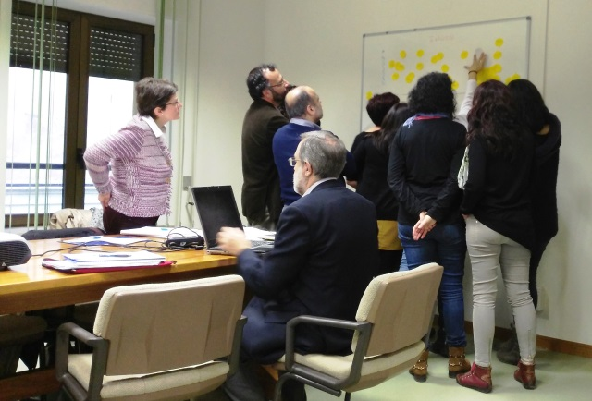
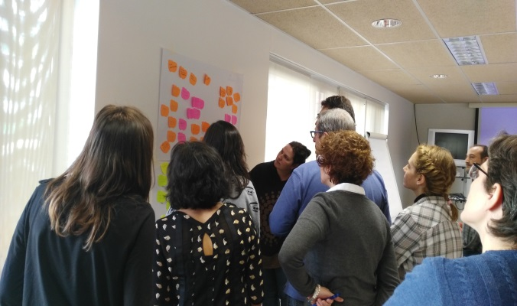
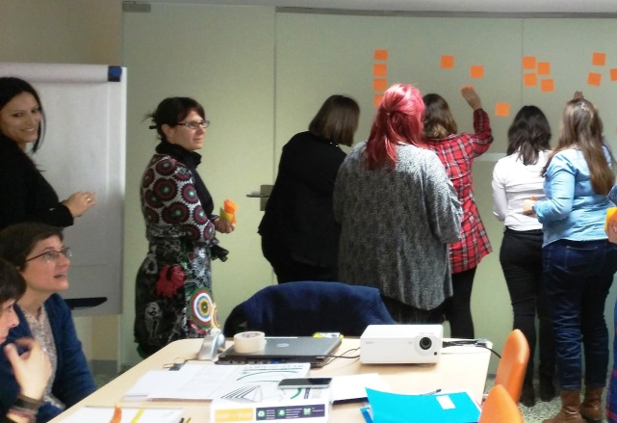
design
This project is
co-funded by the European Union
32 professionals from the local, Third Sector and regional entities, organised in three teams (León, Salamanca and Valladolid) provide their expert knowledge (tons of talent) to develop:
a common language
a common tool of diagnosis (MDTSE)³ directed to the intervention
the keys for a shared intervention model
Multidimensional Tool of Social Exclusion.

Slide 49
design
This project is
co-funded by the European Union
There is collaboration providing knowledge and ideas for the deployment of the Protection Network and preparation for the testing of the approaches of the public-private collaboration network applied to real cases.
The instruments needed for the experimentation are developed:
Manuals of diagnosis, procedure and intervention.
Common documents and questionnaires (informed consent, social shared history, pathway graphics, diagnosis summary, case plan, case coordination plan, attitudinal questionnaires, monitoring, glossary of terms, etc.).
Repositories and systems for the collection of information from the pilot.
Software / shared functionalities: MDTSE for the diagnosis and PACT-NETWORK unit for the management of users authorizations and shared information (under development).

Slide 50
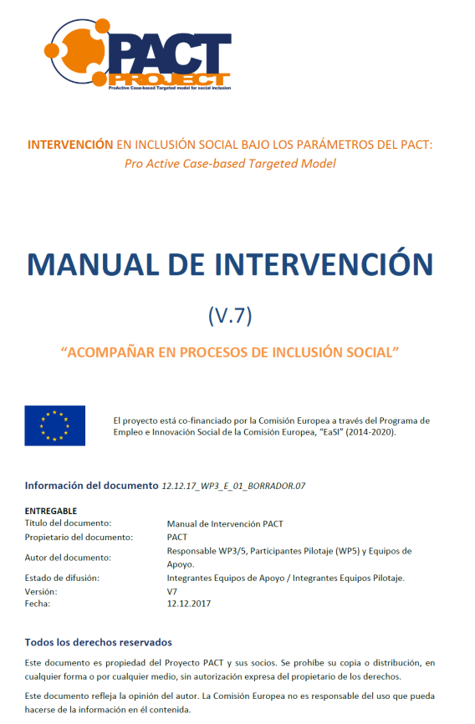
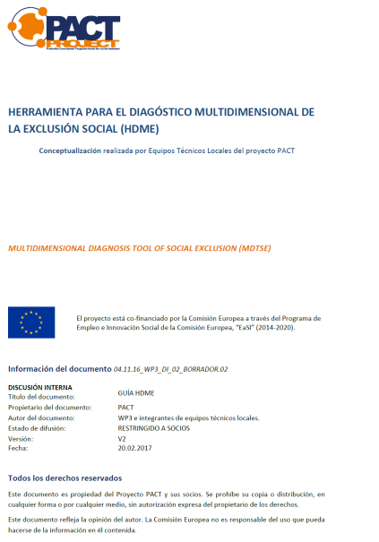
design
This project is
co-funded by the European Union

Slide 51
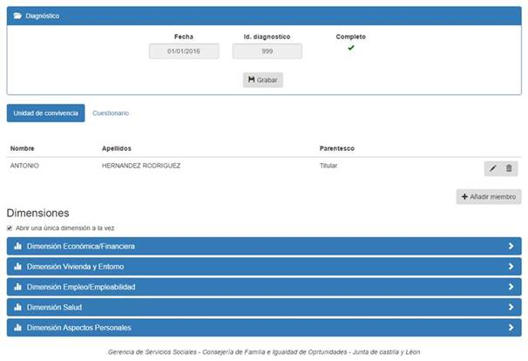
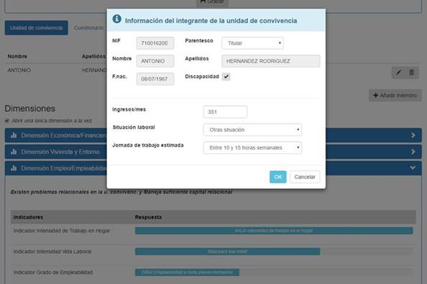
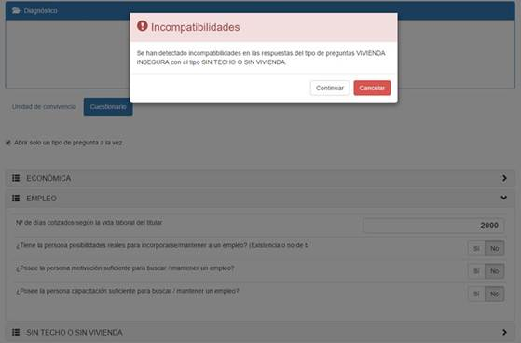
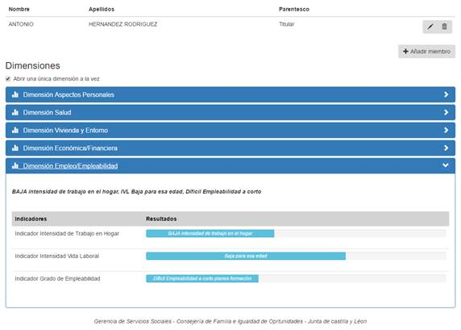
MDTSE
HDME
This project is
co-funded by the European Union
It has been developed a Multidimensional Diagnosis Tool of Social Exclusion (MDTSE)

Slide 52
MDTSE
This project is
co-funded by the European Union
It is a tool for professional use which facilitates a diagnose oriented to the social intervention, from an appreciative approach.
Systematizes the reflection over dynamics of social exclusion/inclusion (risks/opportunities).
Points out the relative position of the person in the imaginary axis of inclusion/exclusion, to orientate the case plan decisions.
Uses a shared language among professionals promoting the exchange.
It allows to create a relational space with the user, in which significative information is generated for the intervention.

Slide 53
MDTSE
This project is
co-funded by the European Union
MONETARY DIMENSION
Salary
Debt
Deprivation
HOME AND ENVIRONMENT
EMPLOYMENT
Residential situation
Urban environment
Intensity of work at home
Intensity of working life
Employability
HEALTH
Health status
Access / adherence
PERSONAL
RELATIONAL
Emotional status
Personal competencies
Relationship with the living unit
Social capital (bonding; bridging/linking)
6 dimensions / 14 indicators + user valuation:

Slide 54
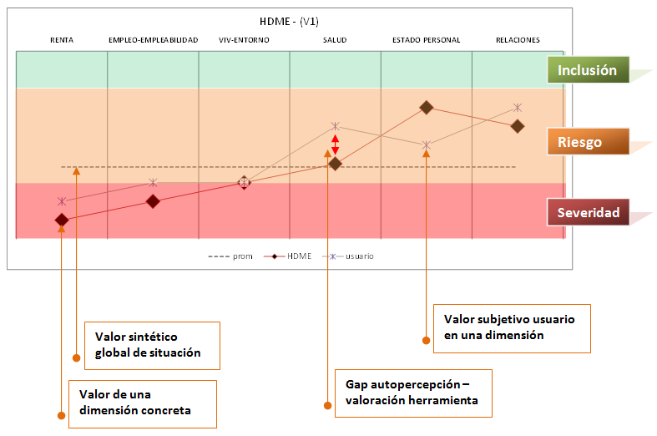
MDTSE
This project is
co-funded by the European Union
Results:
EMPLOYMENT-
EMPLOYABILITY
MDTSE
INCOMES
HOUSING-ENVIROMENT
HEALTH
PERSONAL STATUS
RELATIONSHIPS
Inclusion
Risk
Severity
- - - - - average
MDTSE
beneficiary
Subjective value of bene-ficiary in each dimension
Global synthetic value of situation
Value of a specific dimension
Gap between self-percepcion and tool rating

Slide 55
Informed consent
This project is
co-funded by the European Union
INFORMED CONSENT
Informative document for the user, in which it is explained what does the experimentation consist of, why has he/she been selected, its utility, benefits, commitments and how is it going to be developed.
The consent is requiered to the user (signed) in order to start the intervention, which is volunteer.
WHAT HAS IT ENTAILED FOR THE PROFESSIONAL:
It has been the base for the first contact with the people selected for the sample.
It has been used to explain the Project and it has been shared with all the professionals participating.

Slide 56
Case plan
This project is
co-funded by the European Union
Determination of:
Factors with which we are going to work, always considering the desires and aspirations of the person.
Actions.
Which resources are we going to movilize. Protection Network.
Coordination with the professional of reference to be coherent and aligned with the work that is being developed.
Results and timing in which the case will be reviewed.

Slide 57





Follow us online:
http://www.pact-project.eu/
@PACTproject_eu
EUROPEAN FUNDING
This Project has received funding from the European Program of Employment and Social Innovation of the European Commission, “EaSI” (2014-2020). For further information, please check: http://ec.europa.eu/social/easi
The information in this presentation does not necessarily show the oficial opinion of the European Commission. It only shows the opinion of its author and the European Commission is not responsible of the use that could be done of this information.

